Slide 1
Superstore Dashboard
Project By: Siddharth Ganpat Jambhavdekar (C22055)
Mohit Satish Kinge (C22068)
Company Name: Data Talks Lab
Project Description: The project involves creating a dashboard using Power BI to visualize and analyse sales data for the Superstore dataset.

Slide 2
About Company
Data Talks Lab, founded in January 2019 by Karan Thakur, who serves as both the Founder and CTO, is dedicated to helping everyday individuals build the skills they need to launch successful careers in analytics and Full Stack Web Development. Karan Thakur, a Microsoft Certified Trainer, leverages his expertise to guide students through custom learning paths designed to meet their unique needs.
The company offers 1-on-1 coaching and world-class courses in Excel, Power BI, SQL, Tableau, and Machine Learning. This personalized approach has transformed the careers of over 1500 students, providing them with the knowledge and confidence to excel in their chosen fields.
Through these tailored educational experiences, Data Talks Lab is committed to empowering individuals to achieve their professional goals and thrive in the competitive tech industry.

Slide 3
Project Overview
This project is focused on creating a comprehensive dashboard using the Power BI tool. The dashboard is designed to provide insights into the sales performance of a Superstore across various categories and regions.
To create this dashboard, we used the ETL (Extract, Transform, Load) process to clean and process the raw data from the Superstore Sales dataset. The ETL process involved extracting the data from its source, transforming it to make it usable, and loading it into Power BI for analysis.
The Superstore Sales dataset used in this project is a large and complex dataset containing sales data for a retail store over several years. The dataset includes information on sales, profits, discounts, returns, and quantities sold across various product categories, regions, and managers.
Using Power BI, we were able to create interactive visualizations that allow users to easily explore and analyze the data. The dashboard includes a variety of charts, tables, and graphs that provide insights into sales performance, product categories, regions, and managers.
The dashboard includes multiple pages with different visualizations and filters. The client requirements were taken into account during the development process.
Overall, this project demonstrates the power of Power BI in analyzing large datasets and presenting insights in a clear and understandable way.

Slide 4
Key Responsibilities
Extracted the Superstore Sales dataset and cleaned the data.
Performed data transformation and created DAX measures for sales, profit, discount, returns, and quantity sold.
Developed the Power BI dashboard and created multiple pages with different visualizations.
Incorporated client feedback and made changes to the dashboard as needed.

Slide 5
ETL Process
Extract: The Superstore Sales dataset was extracted from the source.
Transform: The data was cleaned and processed to remove duplicates, fix errors, and format the data.
Load: The cleaned data was loaded into Power BI for analysis and visualization.

Slide 6
Data Analysis
After cleaning the data, we have analyzed the Superstore sales dataset by creating various measures and columns.
We first normalized the data and created new columns in order to understand the data properly in order to perform various operations on the data for creating the dashboard.
After normalizing the data we created the measures that include Total Sales, Total Profit, Total Discount, Total Returns, Quantity Sold, etc.
Using these measures and normalized data we created our dashboard.

Slide 7
DAX Expressions
Total Orders = DISTINCTCOUNT(Orders[Order ID])
Total Profit = [Total Revenue] - [T_Cost]
Total Revenue = SUM(Orders[Sales])
Total Sales = SUM(Orders[Sales])
Weekend_Order = CALCULATE([Total Orders], 'Calendar'[Is weekend] = "Yes")
YTD Revenue = CALCULATE(Orders[Total Revenue], DATESYTD('Calendar'[Date]))
Quantity_Sold = SUM(Orders[Quantity])
Previous_Month_Revenue = CALCULATE([Total Revenue], DATEADD('Calendar'[Date], -1, MONTH))
Previous_Month_Order = CALCULATE([Total Orders], DATEADD('Calendar'[Date], -1, MONTH))
High_Ticket_Order = CALCULATE([Total Orders], FILTER(Orders, Orders[Product Price] > [Overall Average Price]))

Slide 8
Dashboard Pages
Main Dashboard Page
Forecast Page
Product Details Page
Product Analysis Page
Shipping Details Page
Top 5 Customers Performance Page
Bottom 5 Customers Performance Page

Slide 9
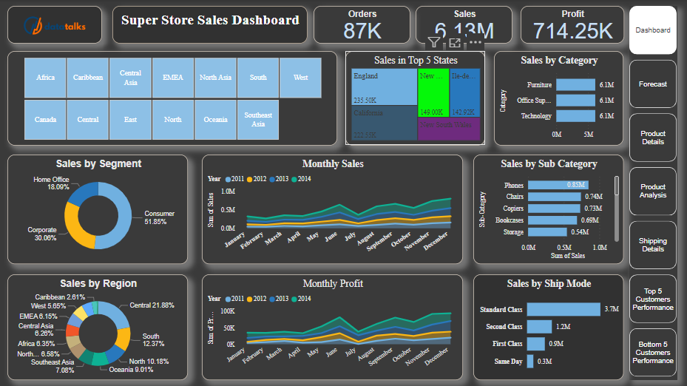
Main Dashboard Page

Slide 10
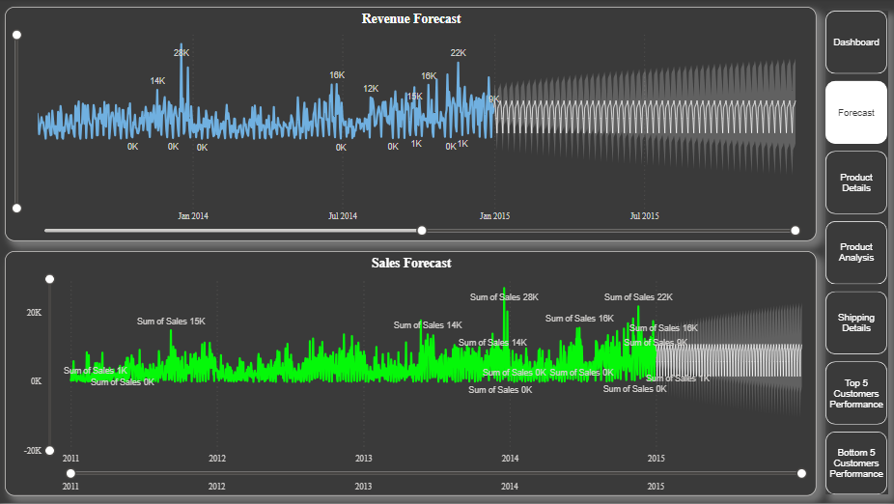
Forecast

Slide 11
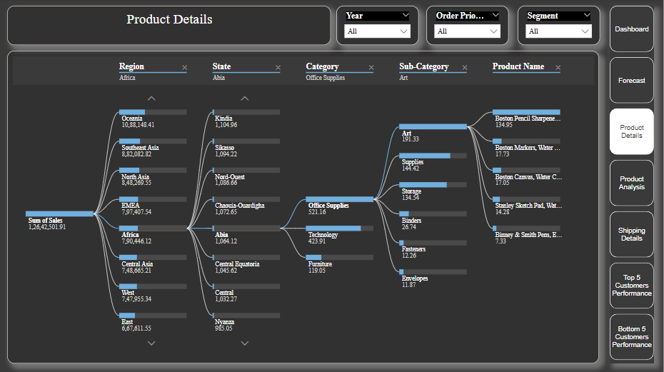
Product Details Page

Slide 12
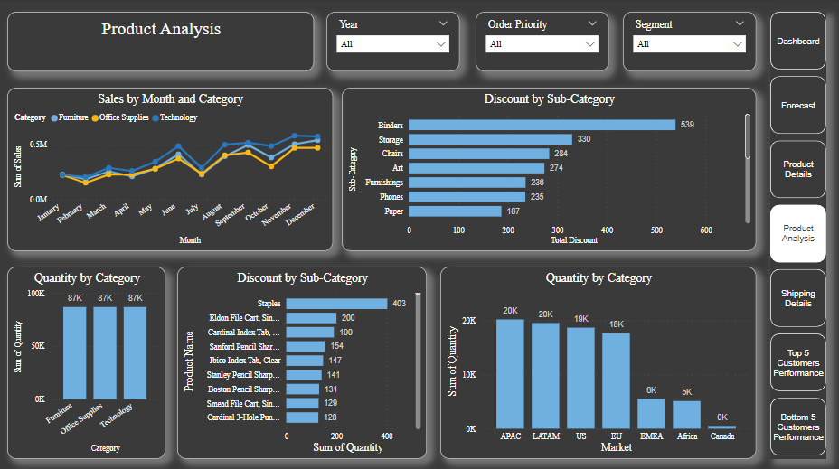
Product Analysis Page

Slide 13
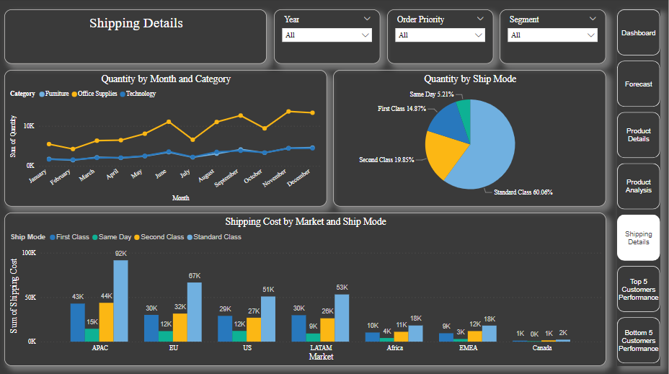
Shipping Details Page

Slide 14
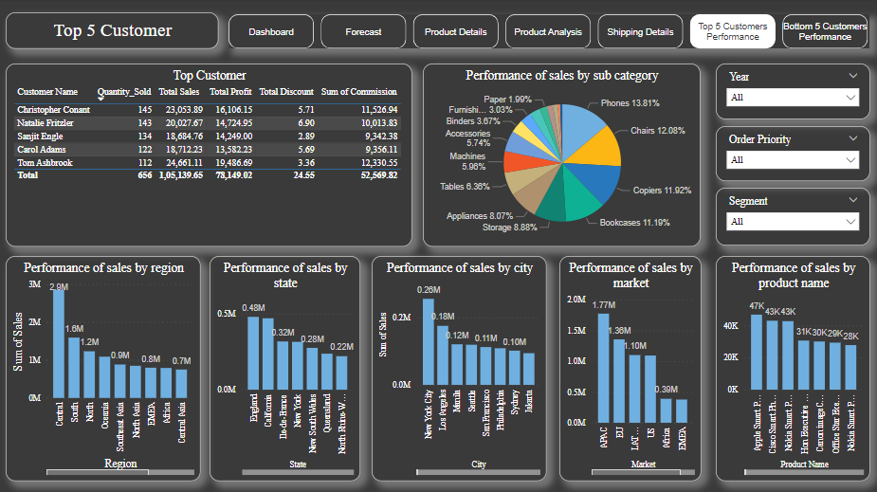
Top 5 Customers Performance Page

Slide 15
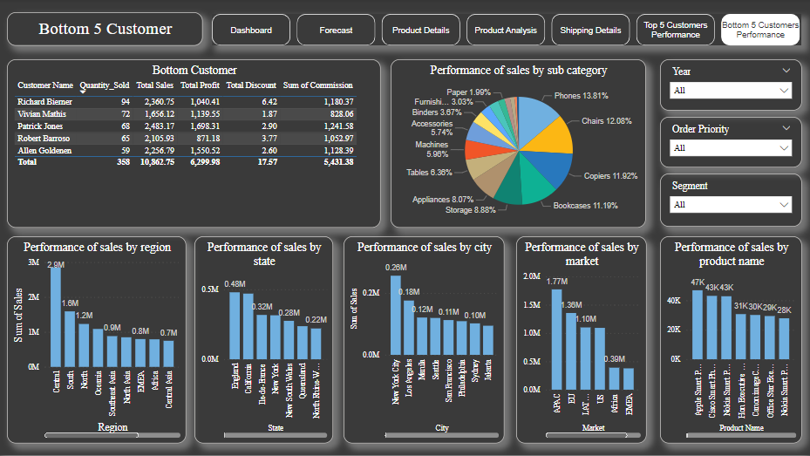
Bottom 5 Customers Performance Page

Slide 16
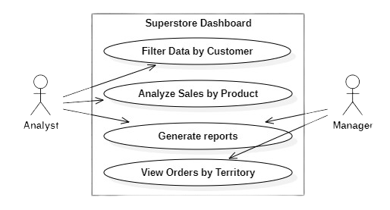
Use Case Diagram

Slide 17
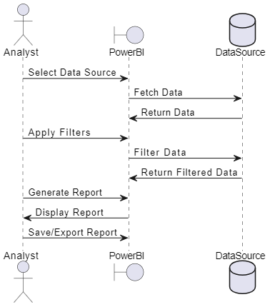
Sequence Diagram

Slide 18
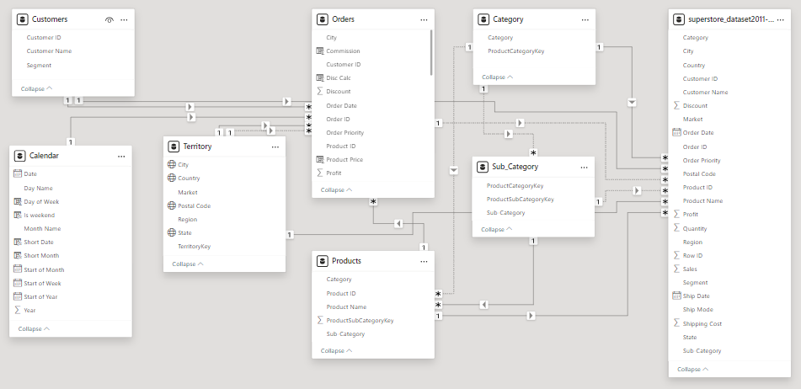
System Flow Chart

Slide 19
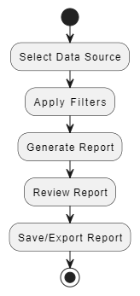
Activity Diagram

Slide 20
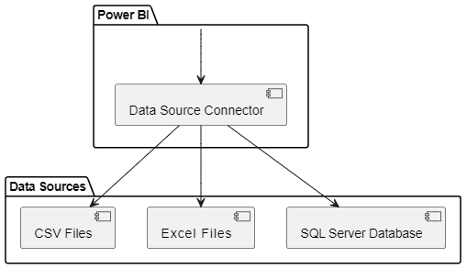
Component Diagram

Slide 21
Conclusion
In conclusion, building a sales dashboard for the Superstore dataset using the Power BI tool required various skills, including data cleaning, data processing, data analysis, and DAX query manipulation.
The seven-page including the Main Dashboard Page, Forecast Page, Product Details Page, Product Analysis Page, Shipping Details Page, Top 5 Customers Performance Page, Bottom 5 Customers Performance Page, helped users to make informed decisions based on the insights provided.
The custom slicer filter and page navigator enhanced the user experience and made navigation and data exploration more convenient. The dashboard provides a comprehensive view of the Superstore's sales performance and facilitates data-driven decision-making.

